Slide 1
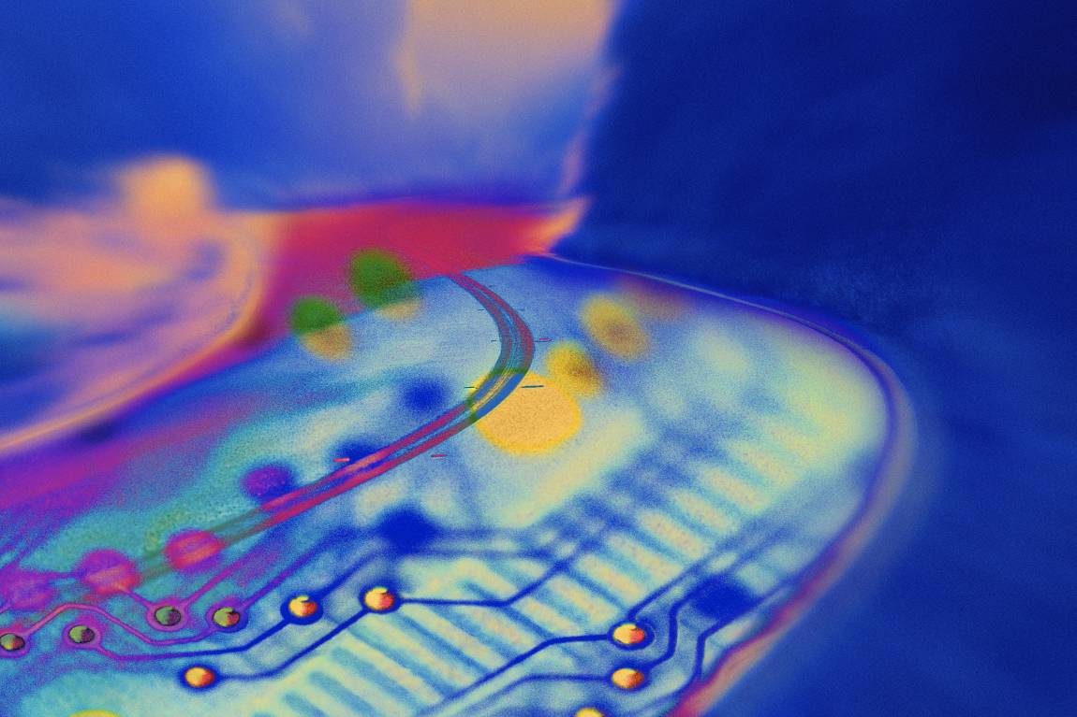
IT Essentials (CompTIA A+) Ch. 5
Random Access Memory (RAM)
Notes:
CUT MANY SLIDES!!!!!!! No such thing as DDR37!!!!!!!!! Make DDR Slides .

Slide 2
Overview
DRAM Packaging
Different kinds of RAM
How to select and install RAM
RAM troubleshooting

Slide 3
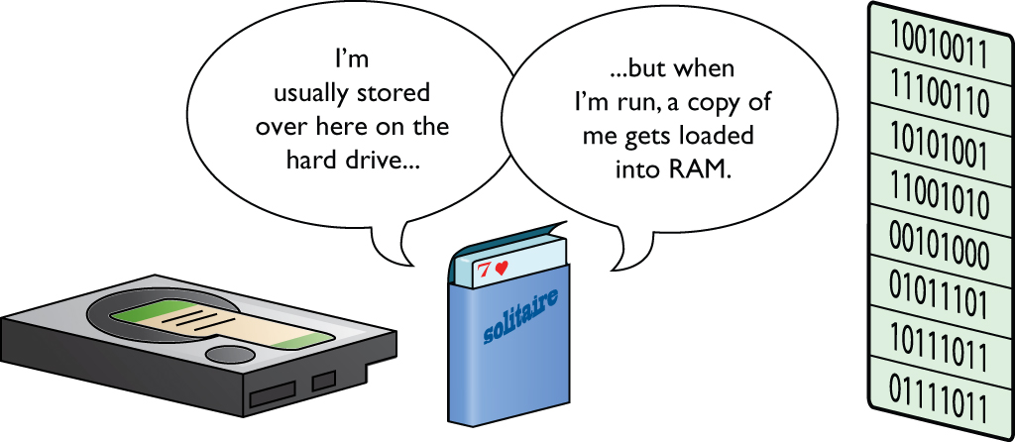
Program Execution
Program Execution
Program code is copied from your hard drive into RAM before it is executed.
Dynamic Random Access Memory (DRAM)
Figure 5.1 Mass storage holds programs, but programs need to run in RAM.

Slide 4
Understanding DRAM
Understanding DRAM
Special semiconductor that temporarily stores ones and zeros in microscopic capacitors and transistors
Refers to byte-wide memory
Can be visualized like a spreadsheet: a 1 MB X 8 RAM stick would be represented as 8 columns wide (8 bits = 1 byte) and 1,048,576 rows deep (1 MB)
Notes:
Programs run in RAM.
Like a big spreadsheet.
That’s how a CPU sees MEMORY SPACE.
CPU simply uses the address bus.

Slide 5
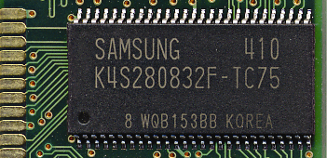
Organizing DRAM
Organizing DRAM
Intel processors since the 8088 require chips to be stored in 8-bit (1-byte) chunks.
Older chips were stored in single bits requiring eight chips to make a byte.
It is not easy to determine actual width or capacity based on what’s written on chips.
Figure 5.2 What do these numbers mean?

Slide 6
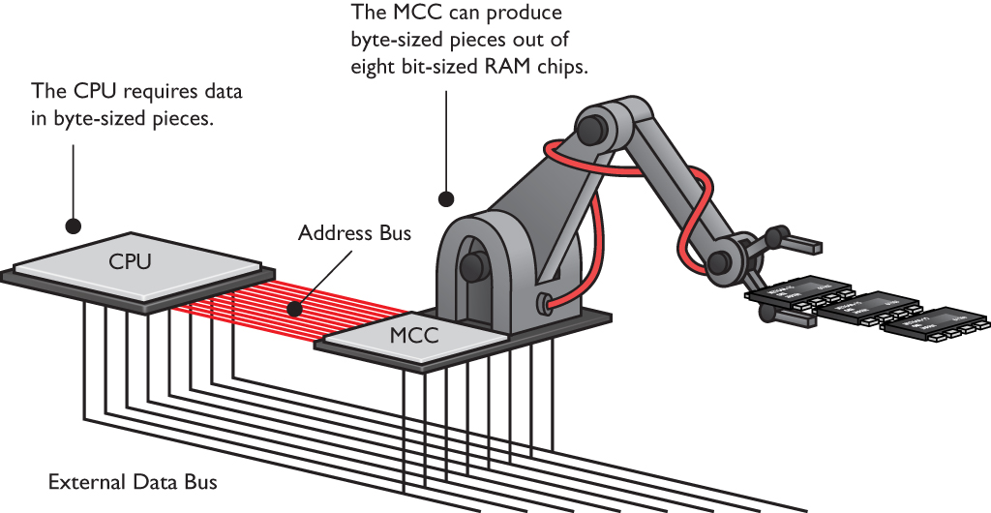
Organizing DRAM
Organizing DRAM
CPU accesses memory via the memory controller chip (MCC).
Figure 5.3 The MCC accessing data on RAM soldered onto the motherboard

Slide 7
Practical DRAM
Practical DRAM
Early RAM on the 8088 used an 8-bit-wide data bus.
Some commands require two bytes.
The 8088 took the command 1 byte at a time.
The MCC had to go to RAM twice so it took twice as long to handle the command.
8086 chip had a 16-bit frontside bus, however, implementing the 8088 with 1-byte RAM made the PC more affordable.

Slide 8
DRAM Sticks
80386 had a 32-bit data bus and thus needed 32-bit-wide DRAM.
If chips were still only 1-bit wide, this would have required a minimum of 32 chips on the board.
DRAM manufacturers began creating wider chips ×4 (4 bits wide), ×8 (8 bits wide), etc.
Multiples of these chips on a circuit board called a stick or module.

Slide 9
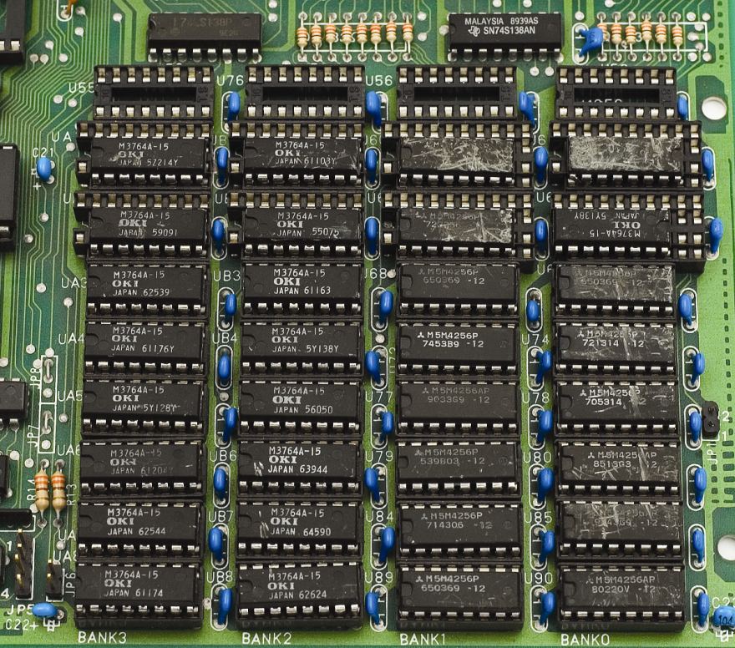
DRAM Sticks
Figure 5.6 That’s a lot of real estate used by RAM chips!

Slide 10
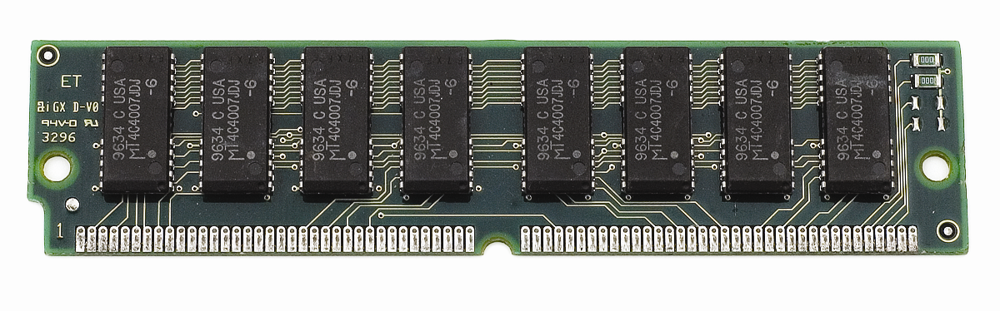
DRAM Sticks
Single inline memory modules (SIMM)
You must get the correct stick(s) for a particular motherboard.
Check the motherboard manual for type of module and amount of RAM you can install.
Figure 5.7 A 72-pin SIMM
Notes:
Exam Tip: Manufacturers made a few 168-pin DIMMs with EDO, but they were rare.

Slide 11
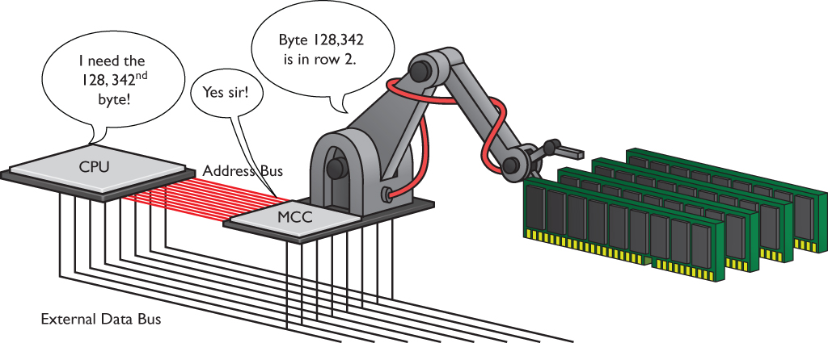
DRAM Sticks
Current RAM is 32 bits wide and 64 bits wide.
The MCC keeps track of the physical location of the RAM.
Figure 5.8 The MCC knows the real location of the DRAM.

Slide 12
Consumer RAM
Modern DRAM modules come in sizes much wider than a byte.
RAM is described by the total capacity in bytes.
For example, 4-GB sticks

Slide 13
Types of RAM
New DRAM technologies are driven by newer, wider, and faster CPUs and MCCs.
Types of RAM:
Synchronous DRAM (SDRAM)
Rambus DRAM (RDRAM)
Double data rate SDRAM (DDR SDRAM)
DDR2 and DDR3
DDR3L/DDR37
DDR4
RAM variations

Slide 14
SDRAM
Synchronized with the system clock
Came on a stick called a dual inline memory module (DIMM)
Came in a wide variety of pin sizes with early DIMMs
168-pin version common on desktops
Laptop DIMMs in 68-pin, 144-pin, or 172-pin micro-DIMM packages
Small-outline DIMM (SO-DIMM) of 72 pins, 144 pins, or 200 pins also for laptops

Slide 15
SDRAM
To use SDRAM, you need a computer designed for it.
Each open slot is called a bank.
Instead of an access speed, it has a clock speed measured in MHz.
Common speeds were 66, 75, 83, 100, and 133 MHz.

Slide 16
RDRAM
RDRAM could support speeds on the frontside bus of up to 800 MHz.
Needed for the quad-pumped CPUs
Originally thought to be the next best thing, RDRAM suffered delays in manufacturing and was significantly more expensive than SDRAM.
A stick of RDRAM was called a RIMM.
Doesn’t stand for anything – SIMMs, DIMMs, and RIMMS rhyme

Slide 17
DDR SDRAM
Fast RAM supported by AMD and other manufacturers
Doubles the throughput over SDRAM (makes two processes for each clock cycle)
Commonly referred to as DDR, DDR RAM, and DDRAM
Comes in 184-pin DIMMs for desktops
Cannot insert RAM in incorrect slots
Slots keyed with guide notches

Slide 18
DDR SDRAM
DDR speed rating and PC speed rating are based on clock speed.
Base clock speed is 100 MHz to 300 MHz with the DDR speed rating double the clock speed.
To determine the PC speed rating (bytes per second), multiply the DDR speed (MHz) by 8.
For example, a chip with a clock speed of 200 MHz has a DDR speed rating of 400 (200 MHz ×2) and would be referred to as a PC-3200 (400 MHz × 8).
DDR SDRAM is supported as PC standard.

Slide 19
DDR SDRAM
Table 5.1 | DDR Speeds
Clock Speed |  | DDR Speed Rating | PC Speed Rating
100 MHz |  | DDR-200 | PC-1600
133 MHz |  | DDR-266 | PC-2100
166 MHz |  | DDR-333 | PC-2700
200 MHz |  | DDR-400 | PC-3200
217 MHz |  | DDR-433 | PC-3500
233 MHz |  | DDR-466 | PC-3700
250 MHz |  | DDR-500 | PC-4000
275 MHz |  | DDR-550 | PC-4400
300 MHz |  | DDR-600 | PC-4800
Notes:
Even though the term DDRxxx is really just for individual DDR chips and the term PCxxxx is for DDR sticks, this tradition of two names for every speed of RAM is a bit of a challenge because you’ll often hear both terms used interchangeably. Table 1 shows all the speeds for DDR—not all of these are commonly used.

Slide 20
DDR SDRAM
Dual-channel architecture uses two sticks of RDRAM together to increase throughput.
Dual-channel DDR requires two identical sticks of DDR, and the sticks must snap into paired slots.

Slide 21
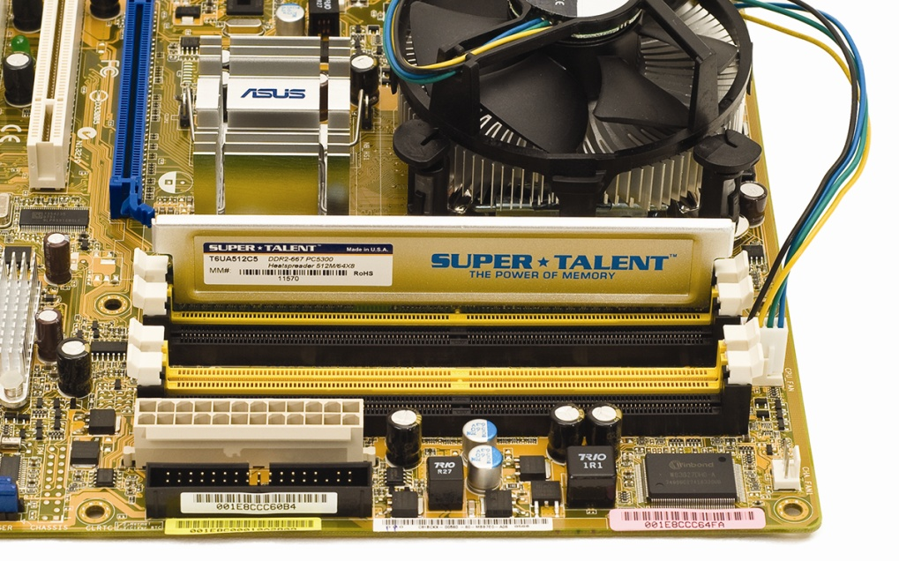
DDR SDRAM
Figure 5.14 A motherboard showing the four RAM slots.
By populating the same color slots with identical RAM,
you can run in dual-channel mode.
Notes:
Some motherboards have three DDR SDRAM slots, but the dual-channel DDR works only if you install DDR SDRAM in two of the slots. Other boards have four slots and you must install matching pairs in the same colored slots to run in dual-channel mode (Figure 5.14).

Slide 22
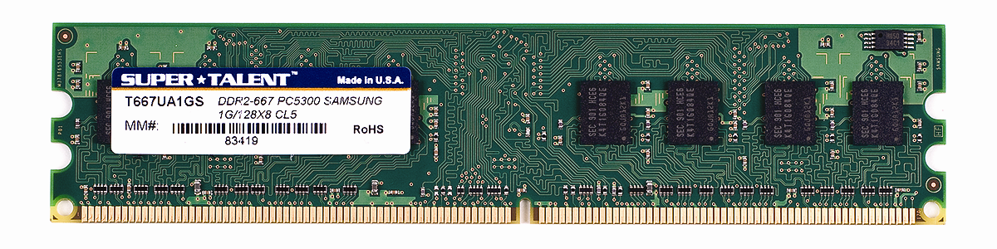
DDR2
DDR2 is DDR RAM with improvements in electrical characteristics to run faster on less power.
Speed increase comes by clock doubling the input/output circuits on the chips.
DDR2 uses 240-pin DIMM (not compatible with DDR DIMM).
Figure 5.15 240-pin DDR2 DIMM

Slide 23
DDR2
Table 5.2 | DDR2 Speeds
Core RAM Clock Speed |  | DDR I/O Speed | DDR2 Speed Rating | PC Speed Rating
100 MHz |  | 200 MHz | DDR2-400 | PC-3200
133 MHz |  | 266 MHz | DDR2-533 | PC-4200
166 MHz |  | 333 MHz | DDR2-667 | PC-5300
200 MHz |  | 400 MHz | DDR2-800 | PC-6400
266 MHz |  | 533 MHz | DDR2-1066 | PC-8500
Notes:
Table 2 shows some of the common DDR2 speeds.

Slide 24
DDR3
DDR3 has higher speeds, more efficient architecture, and 30 percent lower power consumption than DDR2 RAM.
It uses 240-pin DIMM (not compatible with DDR2).
DDR3 doubles the buffer of DDR2 from 4 bits to 8 bits.
Some DDR3 modules also include XMP, or extended memory profile.
Enables overclocking RAM

Slide 25
DDR3
Some chipsets that support DDR3 also support a feature called triple-channel architecture or quad-channel architecture.
Works a lot like dual-channel before it, but with three or four sticks of RAM instead of two
Triple-channel memory is:
Supported by Intel’s LGA 1366 platform
Not supported by AMD processors
Recent Intel and AMD systems support quad-channel memory.

Slide 26
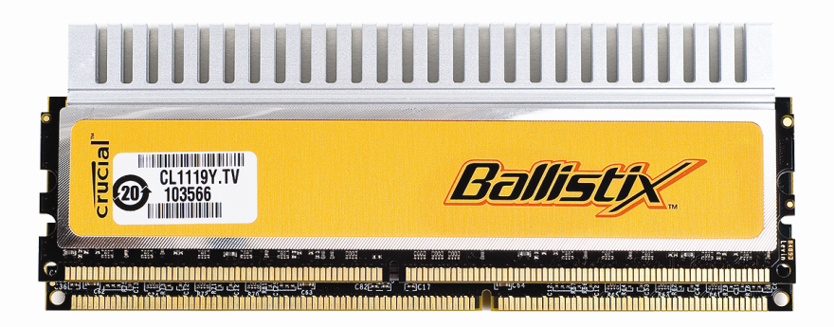
DDR3
DDR3 I/O speeds are quadruple the clock speeds
Due to increased buffer size
Figure 5.16 DDR2 DIMM on
top of a DDR3 DIMM

Slide 27
DDR3
Table 5.3 | DDR3 Speeds
Core RAM Clock Speed |  | DDR I/O Speed | DDR3 Speed Rating | PC Speed Rating
100 MHz |  | 400 MHz | DDR3-800 | PC3-6400
133 MHz |  | 533 MHz | DDR3-1066 | PC3-8500
166 MHz |  | 667 MHz | DDR3-1333 | PC3-10667
200 MHz |  | 800 MHz | DDR3-1600 | PC3-12800
233 MHz |  | 933 MHz | DDR3-1866 | PC3-14900
266 MHz |  | 1066 MHz | DDR3-2133 | PC3-17000
300 MHz |  | 1200 MHz | DDR3-2400 | PC3-19200

Slide 28
DDR3L/DDR3U
DDR3L is a low voltage version of DDR3.
It provides a substantial cost savings when used in massive RAM applications.
DDR3L runs at 1.35 volts.
DDR3U is ultra-low voltage and runs at 1.25 volts.
The DIMM is slot-compatible with DDR3.

Slide 29
DDR4
DDR4 offers higher density and lower voltages than DDR3, and can handle faster data transfer rates.
Runs at only 1.2 volts
Uses 288-pin DIMM
Not backward compatible with DDR3 slots

Slide 30
DDR4
Table 5.4 | DDR4 Varieties
Core RAM Clock Speed |  | Bandwidth | DDR4 Speed Rating | PC Speed Rating
200 MHz |  | 1600 MT/s | DDR4-1600 | PC4-12800
266 MHz |  | 2133 MT/s | DDR4-2133 | PC4-17000
300 MHz |  | 2400 MT/s | DDR4-2400 | PC4-19200
400 MHz |  | 3200 MT/s | DDR4-3200 | PC4-25600

Slide 31
RAM Variations
Double-sided DIMMs
Every type of RAM comes in one of two types: single-sided RAM and double-sided RAM.
Some motherboards can’t use double-sided sticks.
Latency
Numbers reflect how many ticks of the system clock it takes before the RAM responds.
RAM with a lower latency—such as CL6—is faster than RAM with a higher latency—such as CL9.
Goal is to match the RAM with the motherboard applying timing adjustments in BIOS, if needed.

Slide 32
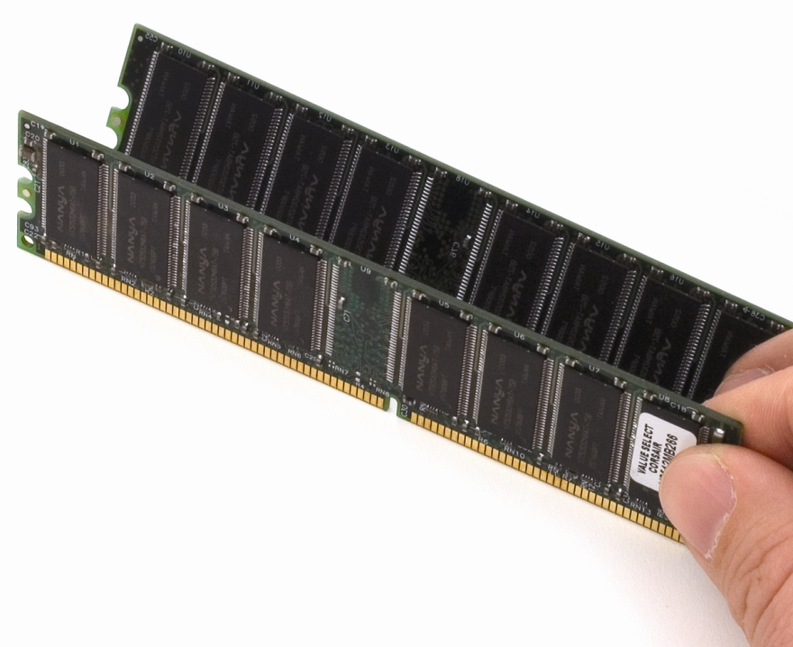
RAM Variations
Figure 5.17 Double-sided DDR SDRAM
Notes:
Double-sided sticks have chips on both sides.

Slide 33
RAM Variations
Parity and ECC
Parity RAM allows the computer to detect whether an error occurred in the reading or writing of data in memory.
Error correction code (ECC) RAM is an improvement over parity, detecting as well as correcting errors.
Always slower than non-ECC RAM because of the extra calculations required
Used only on high-end systems

Slide 34
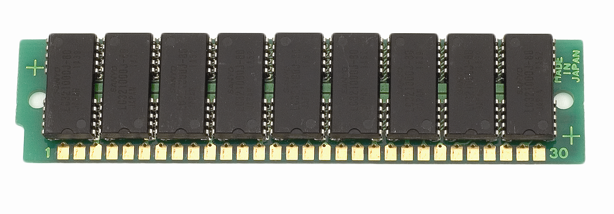
RAM Variations
Figure 5.19 Ancient parity RAM stick
Notes:
The first type of error-detecting RAM was known as parity RAM. Today’s PCs that need to watch for RAM errors use a special type of RAM called error correction code RAM (ECC RAM).

Slide 35
RAM Variations
Registered and buffered memory
Registered RAM (or buffered RAM) refers to a small register installed on some memory modules to act as a buffer between the DIMM and the memory controller.
The motherboard will use either buffered or unbuffered RAM (typical consumer RAM), not both.

Slide 36
Working with RAM
Adding more RAM almost always improves overall system performance, processing speed, and stability
To obtain desired results:
Determine whether insufficient RAM is the cause of system problems.
Pick the proper RAM for the system.
Use good installation practices such as keeping RAM sticks in antistatic packaging and following strict ESD practices.

Slide 37
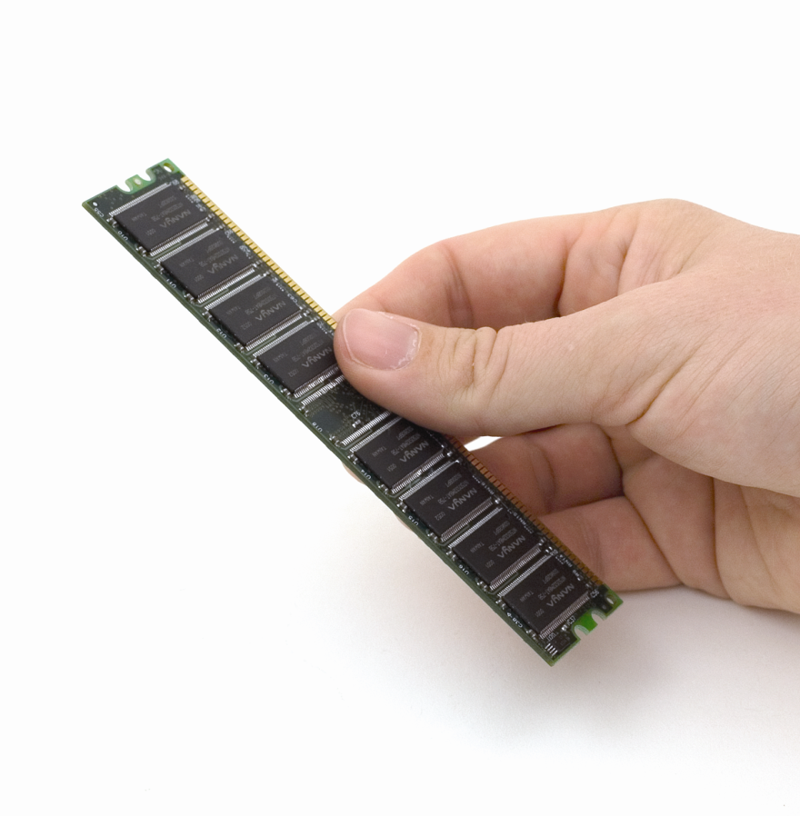
Working with RAM
What's wrong with this picture?
Figure 5.20 Don't do this! Grabbing the contacts is a bad idea!
Notes:
Always store RAM sticks in anti-static packaging whenever they’re not in use, and use strict ESD handling procedures. Like many other pieces of the PC, RAM is very sensitive to ESD and other technician abuse!

Slide 38
Do You Need More RAM?
Two symptoms show the need for more RAM:
General system sluggishness
Excessive hard drive accessing
Programs take forever to load.
Running programs seem to stall and move more slowly than you would like.

Slide 39
Do You Need More RAM?
Virtual memory is a portion of the hard drive used as an extension of RAM.
A portion of an HDD or SSD is set aside as a page file or swap file.
When the PC starts running out of real RAM because you've loaded too many programs, the system swaps programs from RAM to the page file, opening more space for programs currently active.
Disk thrashing occurs when the operating system needs to access the page file too frequently.

Slide 40
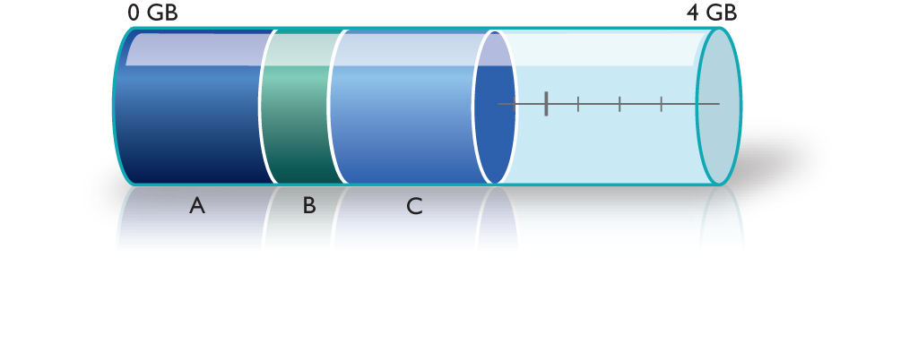
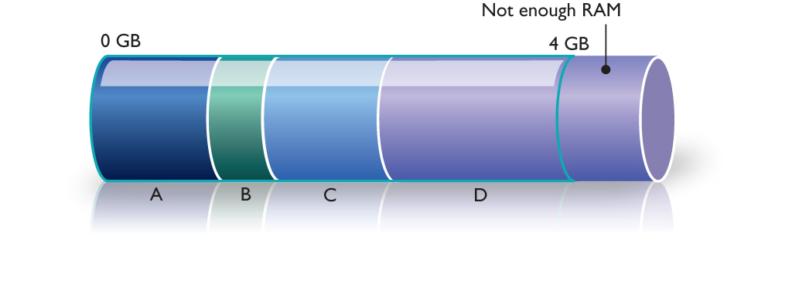
Do You Need More RAM?
Figure 5.21 A RAM thermometer showing that more programs take more RAM
Figure 5.22 Not enough RAM to load program D
Notes:
Let’s assume you have a PC with 4 GB of RAM. Figure 5.21 shows the system RAM as a thermometer with gradients from 0 to 4 GB. As programs load, they take up RAM, and as more and more programs are loaded (labeled A, B, and C in the figure), more RAM is used.
At a certain point, you won’t have enough RAM to run any more programs (Figure 5.22). Sure, you could close one or more programs to make room for yet another one, but you can’t keep all of the programs running simultaneously. This is where virtual memory comes into play.

Slide 41
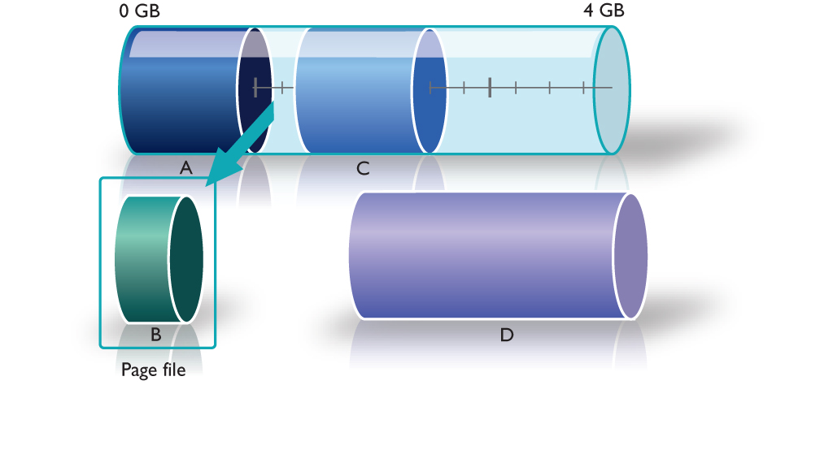
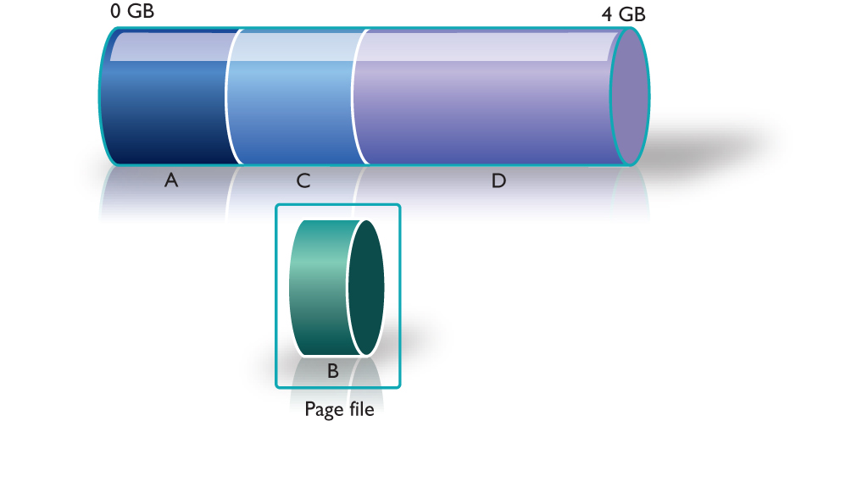
Do You Need More RAM?
Figure 5.23 Program B being unloaded from memory.
Figure 5.24 Program B stored in the page file—room is made for Program D.
Notes:
To load, Program D needs a certain amount of free RAM. Clearly, this requires unloading some other program (or programs) from RAM without actually closing any programs. Windows looks at all running programs—in this case A, B, and C—and decides which program is the least used. That program is then cut out of or swapped from RAM and copied into the page file. In this case, Windows has chosen Program B (Figure 5.23). Unloading Program B from RAM provides enough RAM to load Program D (Figure 5.24).

Slide 42
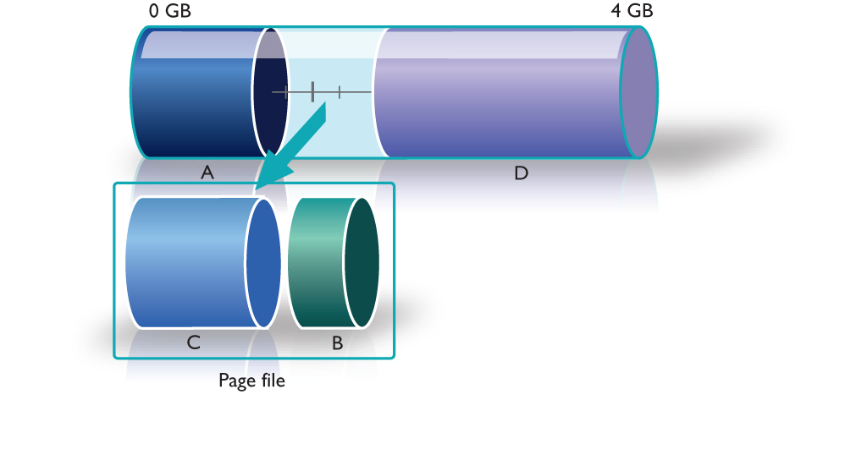
Do You Need More RAM?
Figure 5.25 You can’t tell whether a program is swapped or not.
Figure 5.26 Program C is swapped to the page file.
Notes:
It is important to understand that none of this activity is visible on the screen. Program B’s window is still visible, along with those of all the other running programs. Nothing tells the user that Program B is no longer in RAM (Figure 5.25).
So what happens if you click on Program B’s window to bring it to the front? The program can’t actually run from the page file; it must be loaded back into RAM. First, Windows decides which program must be removed from RAM, and this time Windows chooses Program C (Figure 5.26).

Slide 43
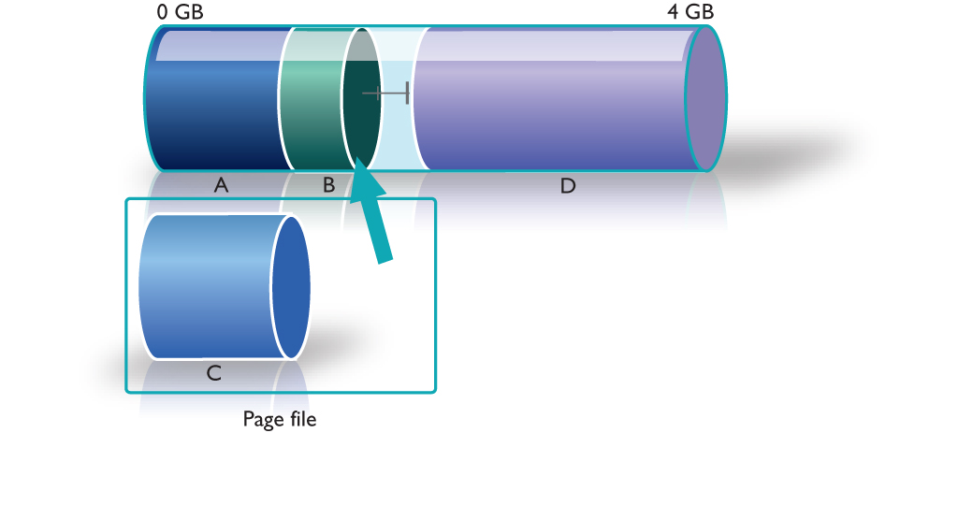
Do You Need More RAM?
Figure 5.27 Program B is swapped back into RAM.
Notes:
Then it loads Program B into RAM (Figure 5.27).

Slide 44
Do You Need More RAM?
System RAM recommendations
Microsoft’s system RAM recommendations for various Windows operating systems are very low.
Consider installing additional memory to reach the reasonable minimum for solid performance or if you are a power user.
32-bit Windows: 2GB to 4GB
64-bit Windows: 4GB to 16+ GB
OS X: 4GB to 8+ GB
Linux: many distros get by on very minimal system requirements

Slide 45
Do You Need More RAM?
Determining current RAM capacity
Uses the System Control Panel applet
ReadyBoost
Featured in Windows Vista and later versions
Enables use of flash media devices as dedicated virtual memory

Slide 46
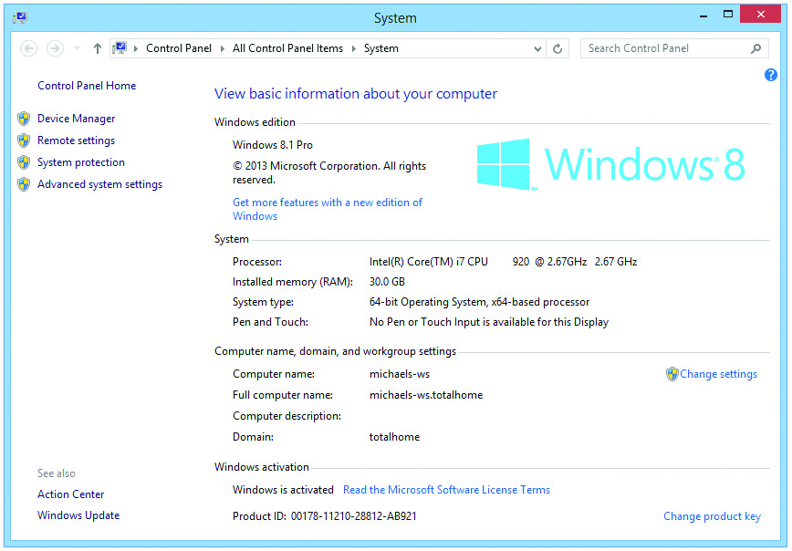
Do You Need More RAM?
Figure 5.28 Mike has a lot of RAM!

Slide 47
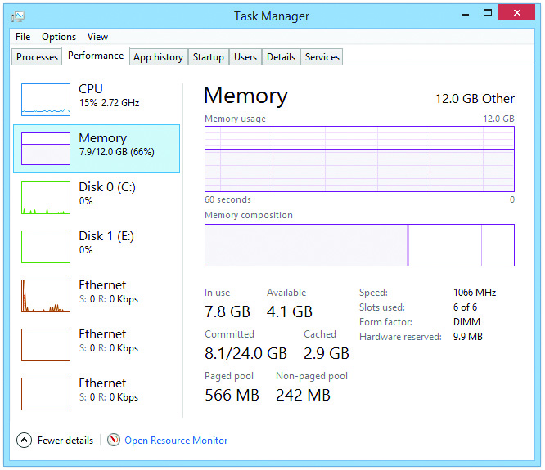
Do You Need More RAM?
Figure 5.29 Performance tab in Windows 8.1 Task Manager
Notes:
You can diagnose excessive disk thrashing through simply observing the hard drive access LED flashing or through

Slide 48
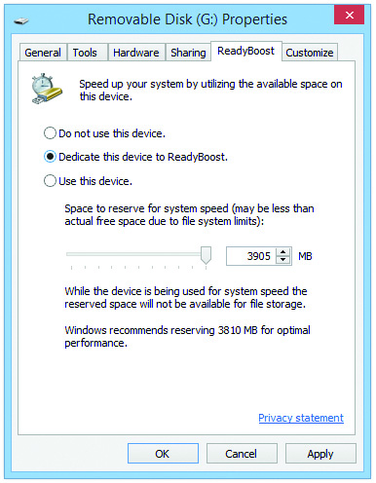
Do You Need More RAM?
Figure 5.30 Dedicating a flash drive to ReadyBoost to enhance system performance.

Slide 49
Getting the Right RAM
To achieve the perfect RAM upgrade:
Determine the optimum amount of RAM to install and then get the right RAM for the motherboard.
Information inside the case and in the motherboard manual
Example: You can’t put DDR4 into a system that can only handle DDR3 SDRAM.
RAM limits are specified in the motherboard manual.

Slide 50
Getting the Right RAM
Mix and match at your peril.
Different RAM sizes aren’t always handled well in motherboards.
It’s best to choose RAM sticks that match technology, capacity, and speed.
It’s best not to mix speeds.
You can place higher-rated RAM into a slower-rated motherboard, but the RAM will work at the slower rate of the motherboard.

Slide 51
Installing DIMMs
This is an easy process even for non-techie folks.
Line up the notches and place the stick in the slot.
Push down and the tabs will lock into position.

Slide 52
Installing DIMMs
Serial Presence Detect (SPD) technology detects and automatically sets up installed DIMM.
When a PC boots, it queries the SPD chip so that the MCC knows how much RAM is on the stick, how fast it runs, and other information.
Any program can query the SPD chip to obtain RAM information.
CPU-Z is a program that displays some of the RAM information from the SPD chip.

Slide 53
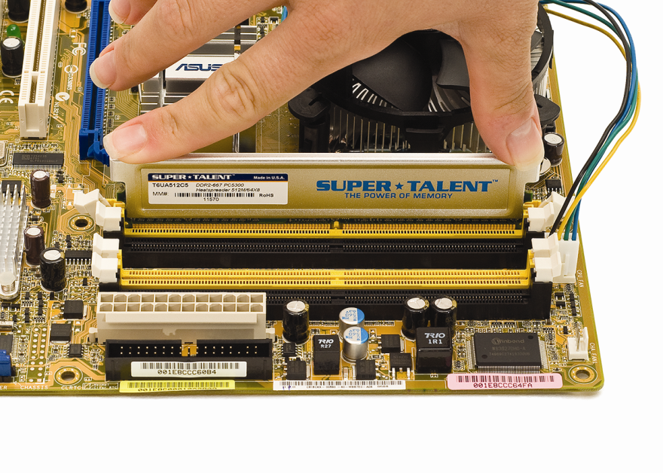
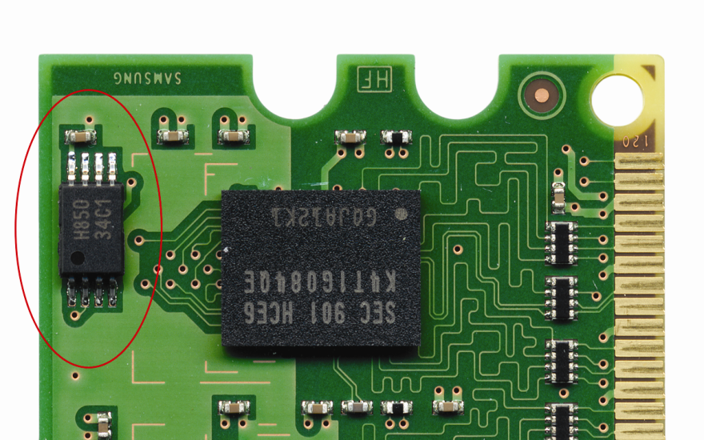
Installing DIMMs
Figure 5.32 Inserting a DIMM
Figure 5.33 SPD chip on a stick
Notes:
Pick up a stick of RAM—don’t touch those contacts—and line up the notch or notches with the raised portion(s) of the DIMM socket (Figure 5.32).
Your motherboard should detect and automatically set up any DIMM or RIMM you install, assuming you have the right RAM for the system, using a technology called serial presence detect (SPD). RAM makers add a handy chip to modern sticks called the SPD chip (Figure 5.33). The SPD chip stores all the information about your DRAM, including size, speed, ECC or non-ECC, registered or unregistered, and a number of other more technical bits of information.

Slide 54
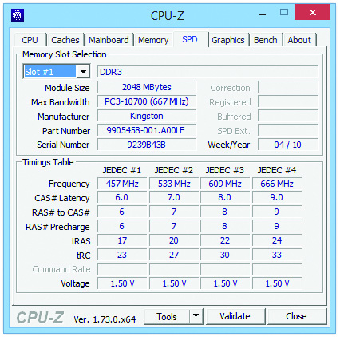
Installing DIMMs
Figure 5.34 CPU-Z showing RAM information
Notes:
Figure 5.34 displays the results of the popular CPU-Z program showing RAM information from the SPD chip.

Slide 55
Installing DIMMs
The RAM count
Older systems display the RAM count during the initial boot sequence.
If you installed the RAM correctly, the RAM count on the PC reflects the new value.
If the RAM value stays the same, you probably have installed the RAM in a slot the motherboard doesn’t want you to use.

Slide 56
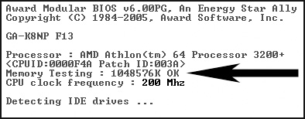
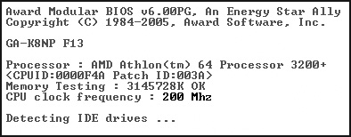
Installing DIMMs
Figure 5.35 Hey, where’s the rest of my RAM?!
Figure 5.36 RAM count after proper insertion of DIMMs
Notes:
After installing the new RAM, turn on the PC and watch the boot process closely. If you installed the RAM correctly, the RAM count on the PC reflects the new value (compare Figures 5.35 and 5.36).

Slide 57
Installing SODIMMs
For years, laptops had proprietary RAM packages, making this difficult.
However, the acceptance of SO-DIMMs over the years has made it much easier.
First, power off, unplug, and remove the battery pack—follow ESD procedures.
Identify the access point for the SO-DIMM.
This is usually either under the keyboard or via an access panel on the back.
Replace the SO-DIMM.

Slide 58
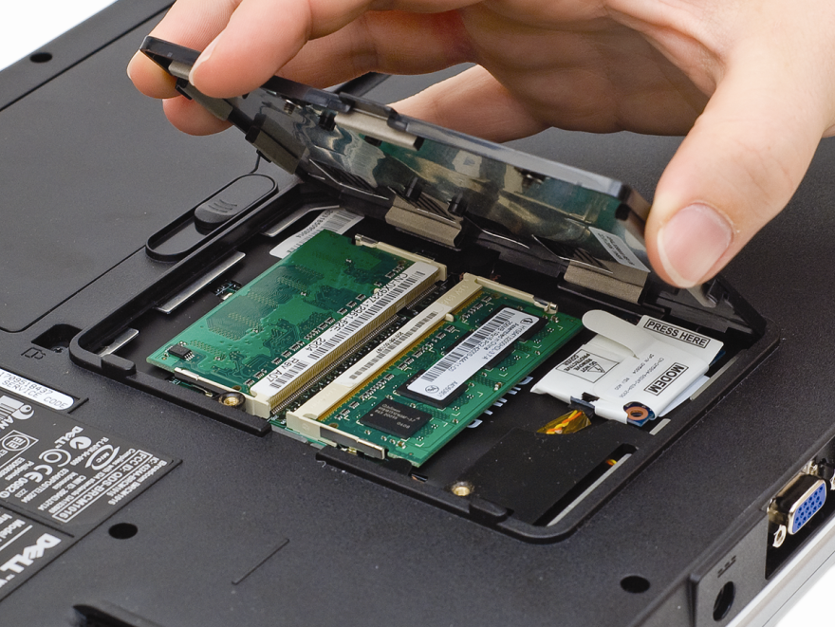
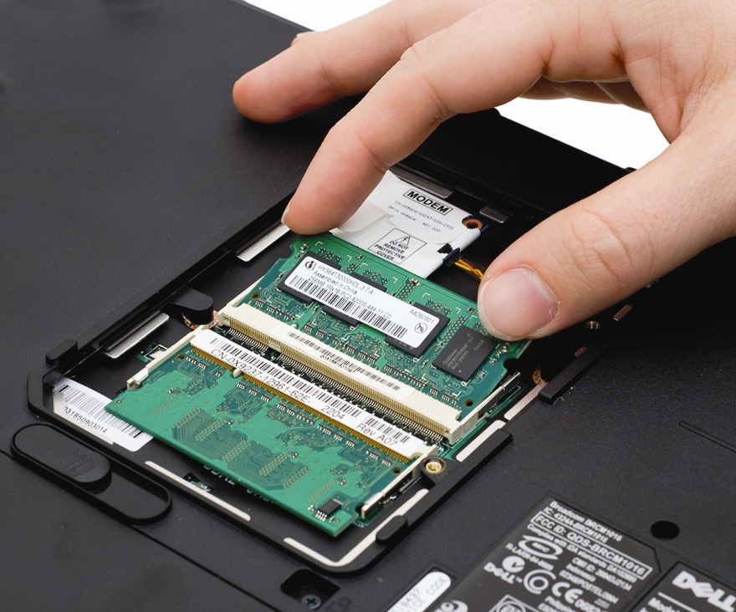
Installing SO-DIMMs
Figure 5.37 A RAM access panel on a laptop
Figure 5.38 Snapping in a SO-DIMM
Notes:
Access to RAM usually requires removing a panel or lifting up the keyboard—the procedure varies among laptop manufacturers. Figure 5.37 shows a typical laptop RAM access panel. You can slide the panel off to reveal the SO-DIMMs. SO-DIMMs usually insert exactly like the old SIMMs; slide the pins into position and snap the SO-DIMM down into the retaining clips (Figure 5.38).

Slide 59
Troubleshooting RAM
“Memory” errors show up in a variety of ways on modern systems, including:
Parity errors
ECC error messages
System lockups
Page faults
Other error screens
Parity error types include:
Real parity errors
Phantom parity errors

Slide 60
Troubleshooting RAM
Memory errors can include:
Page fault – not necessarily RAM problems
Non-maskable interrupt (NMI) – panic button inside the PC
Manifests as proprietary crash screen—Blue Screen of Death (BSoD) in Windows Vista and Windows 7 and the pinwheel of death in Mac OS X
Not all intermittent errors are RAM-related.
Dying power supply, electrical interference, and buggy applications or hardware can also produce intermittent errors.

Slide 61
Testing RAM
Use a RAM-testing device.
Replace one stick at a time until problems disappear.
Run a software-based tester on the RAM.
Windows Memory Diagnostic tool is included with Windows 7 and later.
Memtest86+ software from memtest.org is another example.

Slide 62
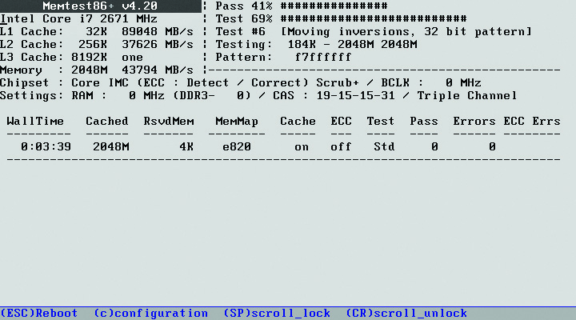
Testing RAM
Figure 5.40 Memtest86+ in action
Notes:
Windows 7 includes the Memory Diagnostics Tool, which can automatically scan your computer’s RAM when you encounter a problem. If you’re using another OS, one tool you can use is Memtest86 written by Mr. Chris Brady (www.memtest86.com). Memtest86 exhaustively checks your RAM and reports bad RAM when it finds it (Figure 5.40).

Slide 63
Questions?

Slide 64
Summary
DRAM Packaging
Different kinds of RAM
How to select and install RAM
RAM troubleshooting

Slide 65


